Slide 1
Cascading Style Sheets
Declaration Properties

Slide 2

What is an App?
Alpha Anywhere Apps are a collection of HTML, CSS, and JavaScript*
HTML is the Content
JavaScript is the Interaction
CSS is the Look & Feel

Slide 3
What is CSS?
Wikipedia (https://en.wikipedia.org/wiki/CSS)
Cascading Style Sheets (CSS) is a style sheet language used for describing the presentation of a document written in a markup language such as HTML.

Slide 4
Where is CSS Used in Alpha Apps?
Web Theme Builder
Inherited Styles
Style Tweaks
Color Palettes
Sub-themes
Component CSS
Control Properties
Control CSS
In-line CSS
Externally Linked Stylesheets

Slide 5
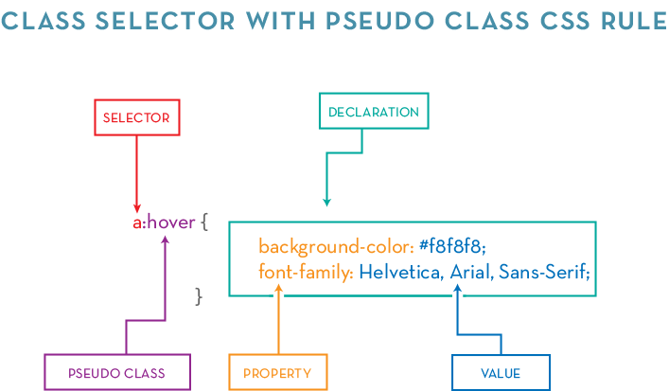
Anatomy of a CSS Rule

Slide 6
Adding CSS
Web Theme Builder, Component Styles, Externally linked CSS: specified as selectors with declarations
.blue { color: blue; }
Control Properties, Control CSS, In-line CSS: specified as declarations or class names
font-weight:bold; color:blue; border: 1px solid black;

Slide 7
Some Useful CSS Properties
margin
padding
display
width
height
Notes:
Useful properties documentation:
margin: https://developer.mozilla.org/en-US/docs/Web/CSS/margin
padding: https://developer.mozilla.org/en-US/docs/Web/CSS/padding
display: https://developer.mozilla.org/en-US/docs/Web/CSS/display
width: https://developer.mozilla.org/en-US/docs/Web/CSS/width
min-width: https://developer.mozilla.org/en-US/docs/Web/CSS/min-width
max-width: https://developer.mozilla.org/en-US/docs/Web/CSS/max-width
height: https://developer.mozilla.org/en-US/docs/Web/CSS/height
min-height: https://developer.mozilla.org/en-US/docs/Web/CSS/min-height
max-height: https://developer.mozilla.org/en-US/docs/Web/CSS/max-height

Slide 8
Some Useful CSS Properties
background
border
border-radius
box-shadow
opacity
Notes:
Useful properties documentation:
background: https://developer.mozilla.org/en-US/docs/Web/CSS/background
border: https://developer.mozilla.org/en-US/docs/Web/CSS/border
border-radius: https://developer.mozilla.org/en-US/docs/Web/CSS/border-radius
box-shadow: https://developer.mozilla.org/en-US/docs/Web/CSS/box-shadow
opacity: https://developer.mozilla.org/en-US/docs/Web/CSS/opacity

Slide 9
Some Useful CSS Properties
font-family
font-style
font-weight
text-decoration
color
overflow
white-space
direction
Notes:
Useful properties documentation:
font-family: https://developer.mozilla.org/en-US/docs/Web/CSS/font-family
font-style: https://developer.mozilla.org/en-US/docs/Web/CSS/font-style
font-weight: https://developer.mozilla.org/en-US/docs/Web/CSS/font-weight
text-decoration: https://developer.mozilla.org/en-US/docs/Web/CSS/text-decoration
color: https://developer.mozilla.org/en-US/docs/Web/CSS/color
overflow: https://developer.mozilla.org/en-US/docs/Web/CSS/overflow
white-space: https://developer.mozilla.org/en-US/docs/Web/CSS/white-space
direction: https://developer.mozilla.org/en-US/docs/Web/CSS/direction

Slide 10


Slide 11
CSS Resources
CSS-Tricks
https://css-tricks.com
MDN
https://developer.mozilla.org/en-US/docs/Web/CSS
A List Apart
https://alistapart.com
Smashing Magazine
https://www.smashingmagazine.com

